Slide 1

AI Image Pathology Diagnosis Lawrence Chan Department of Health Technology and Informatics, Hong Kong Polytechnic University

Slide 2

Pathology

Slide 3
Pathology Diagnosis
Cellular pathology is the study of disease in organs, tissues and cells.
Histopathology and cytopathology are key diagnostic tests in the initial detection and diagnosis of cancer and other diseases supported by modern molecular techniques.
Consultant cellular pathologists can provide information on prognosis and help to appropriately direct therapies in post diagnostic treatment.
https://www.nbt.nhs.uk/severn-pathology/pathology-services/cellular-pathology/what-cellular-pathology

Slide 4
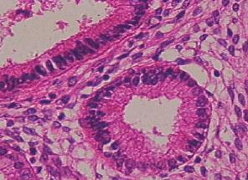
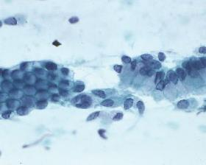
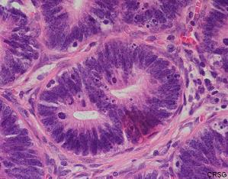
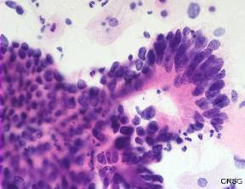
Endocervical Glands
Histopathology
Cytopathology
Normal
Histopathology
Cytopathology
Cancerous
www.themegallery.com

Slide 5
Histopathology
Histopathology is the diagnosis and study of diseases of the tissues, and involves examining tissues and/or cells under a microscope.
Histopathologists are responsible for making tissue diagnoses and helping clinicians manage a patient's care.

Slide 6
Cytopathology
Cytopathology is the use of specialist diagnostic techniques to examine individual cells extracted from tissues to determine the cause and nature of a disease.
Cell samples may be gathered during routine diagnostic tests, such as bronchoscopy and cystoscopy.

Slide 7
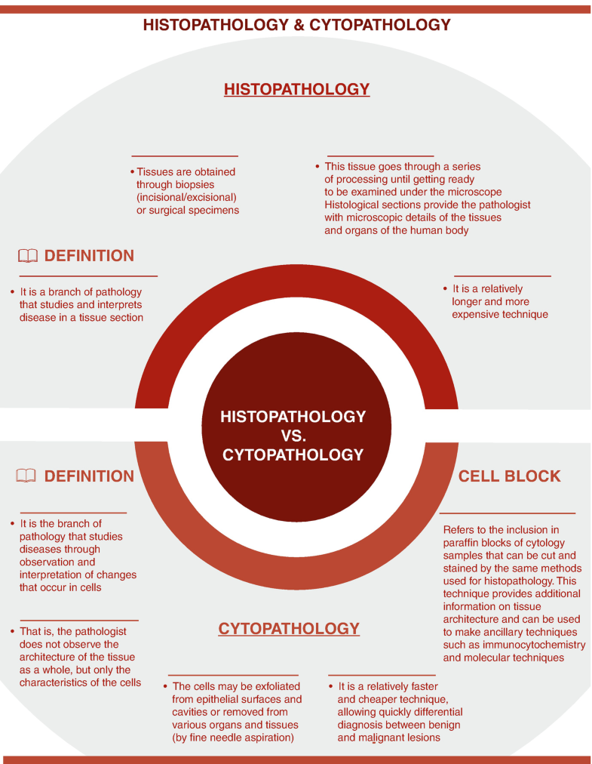

Slide 8
Liquid-based preparation (LBP) cytology
Liquid-based cytology (LBC) is being extensively used for both gynecological and nongynecological specimens.
This technique enables cells to be suspended in liquid medium and spread in monolayer and thus, permitting better morphological assessment.
Two widely used technologies of LBC are ThinPrep (TP) (Hologic, Marlborough, MA, USA) and BD SurePath (BD Diagnostics - TriPath, Burlington, NC, USA)

Slide 9
Liquid-based preparation (LBP) cytology
Liquid-based cytology is an innovative cytological slide preparation technology introduced in recent years.
Compared with traditional smears, liquid-based cytology preserves specimens through preservation solutions, goes through a series of process, removes the impurities in the specimen, and make a clear slide under the microscope.
Diagnostic accuracy and sensitivity are significantly improved.

Slide 10
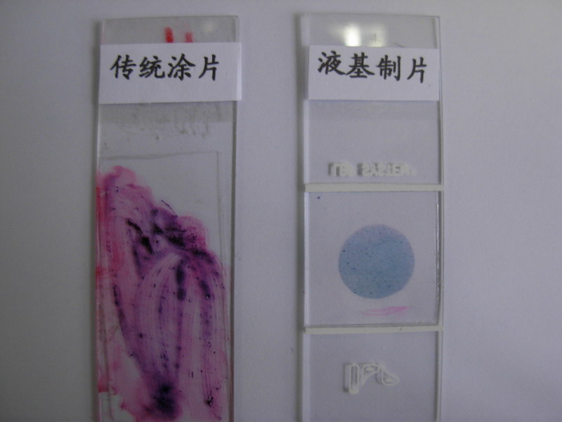
Liquid-based preparation (LBP) cytology

Slide 11
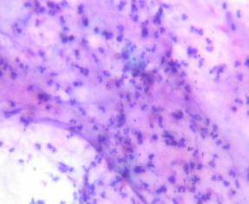
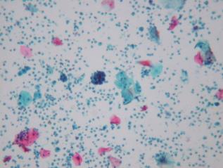
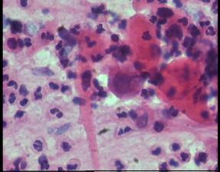
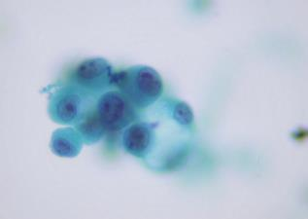
Liquid-based preparation (LBP) cytology

Slide 12
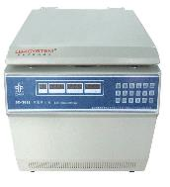
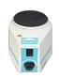
Liquid-based preparation (LBP) cytology

Slide 13
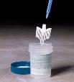
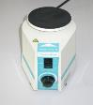
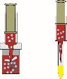
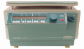
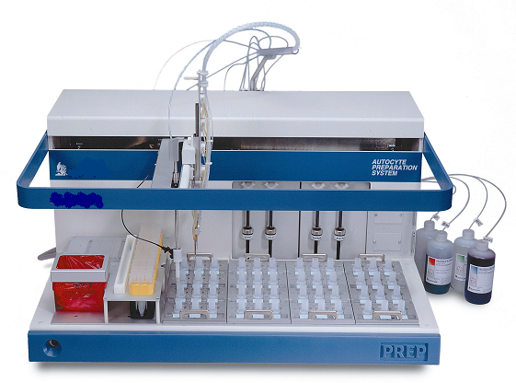
Liquid-based preparation (LBP) cytology
Specimen collection and slide preparation process
1. Collect specimens
2. Vibration
3. Transfer
4. Gradient centrifugation
5. Slide preparation / staining
Fully automatic and standardized film production process to ensure efficient, stable and high-quality film preparation

Slide 14
Bronchial Brushing procedure
A bronchial brushing is used to find cancer and changes in cells that may lead to cancer.
It is also used to help diagnose other lung conditions.
Also called bronchial brush biopsy

Slide 15
Bronchial Brushing procedure
A procedure in which cells are taken from the inside of the airways that lead to the lungs.
A bronchoscope (a thin, tube-like instrument with a light and a lens for viewing) is inserted through the nose or mouth into the lungs.
A small brush is then used to remove cells from the airways.
These cells are then looked at under a microscope.

Slide 16
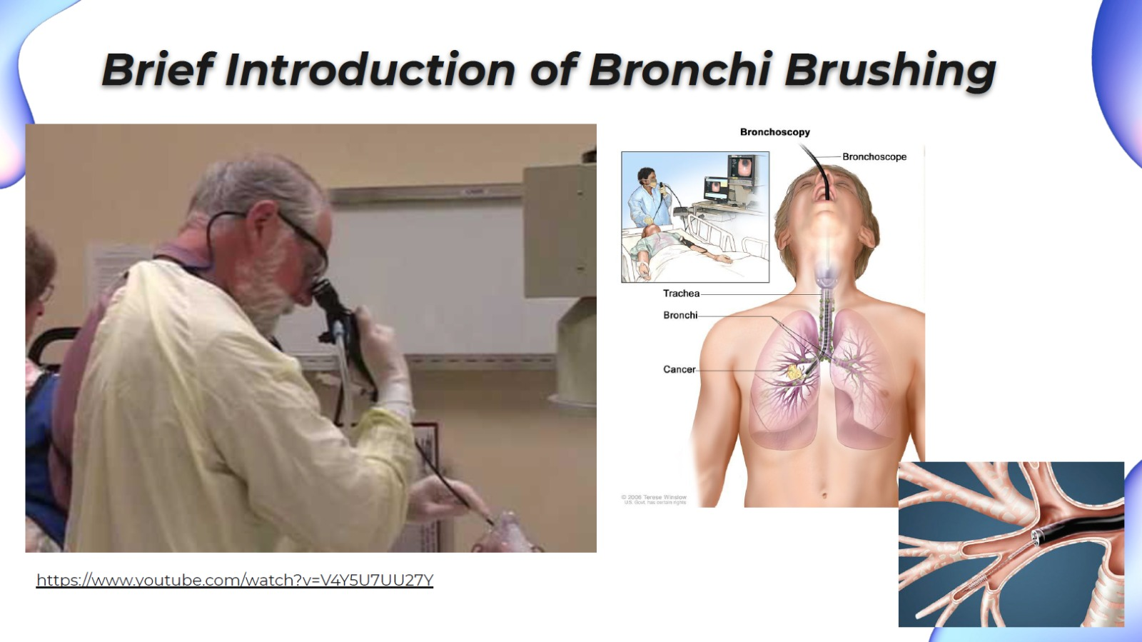

Slide 17
Respiratory epithelium
Also called airway epithelium
A type of ciliated columnar epithelium found lining most of the respiratory tract as respiratory mucosa where it serves to moisten and protect the airways

Slide 18
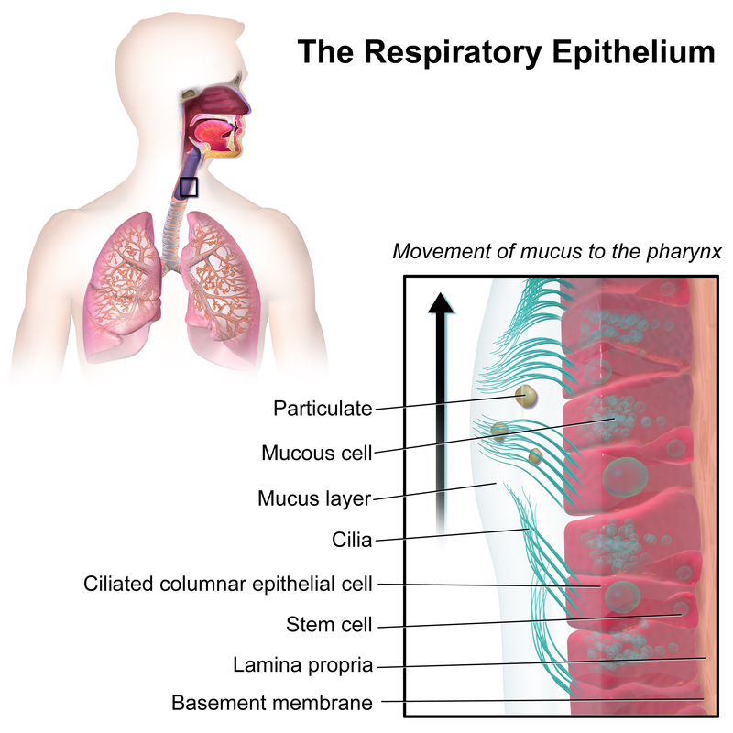
Respiratory epithelium
Four main cell types:
ciliated cells,
goblet cells
club cells, and
airway basal cells
goblet cells
Club cells, basal cells

Slide 19
Respiratory epithelium
The trachea and main bronchial epithelium are covered with two or more layers of columnar cells, but not all of them extend to the surface of the epithelium.
Cells that do not extend to the surface have no cilia. This is an example of spatial arrangement that determines cell differentiation.
In the smaller branches of the bronchus, the number of goblet cells and ciliated cells gradually decreases, becoming some cube cells.

Slide 20
Respiratory epithelium
The ciliated columnar epithelium is easy to form a cluster and fall off.
The liquid-based slide shows a densely stained cell cluster.
The interpretation is difficult, no matter under a microscope or AI recognition.

Slide 21
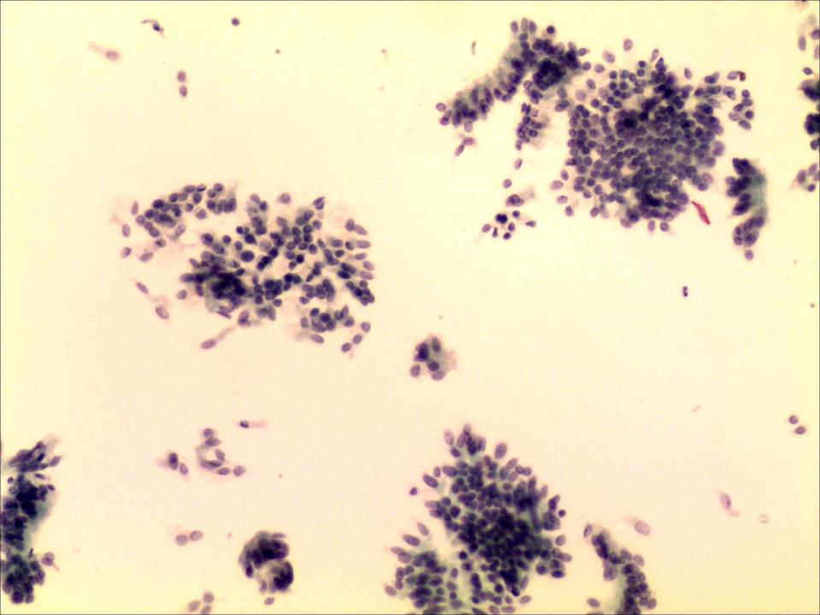
Respiratory epithelium
LBP Slide

Slide 22
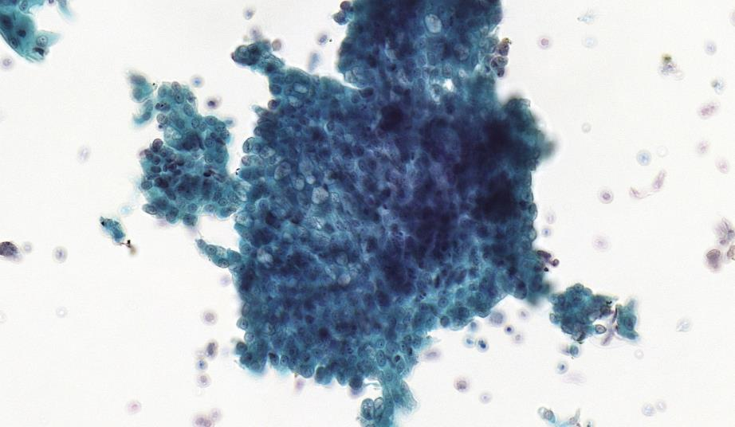
LBP Slide

Slide 23
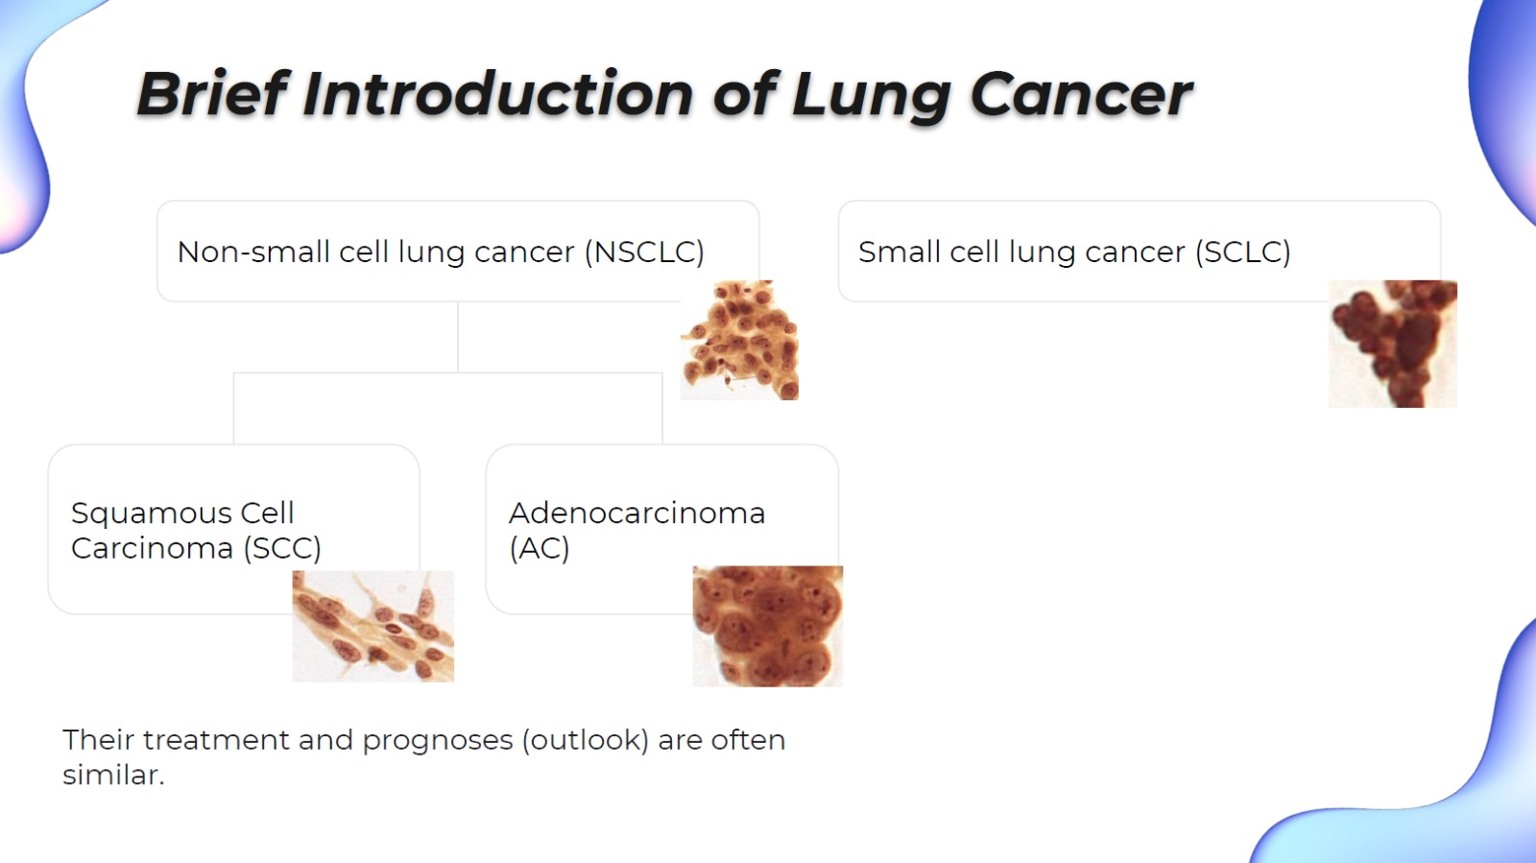
Classification of Lung Cancer
Large Cell Carcinoma

Slide 24
Classification of Lung Cancer in dataset for this competition
image_id | xmin | ymin | xmax | ymax | scc | ac | sclc | nsclc
sample_0000 | 0.348 | 0.4096 | 0.4405 | 0.7364 | 0 | 0 | 1 | 0
sample_0000 | 0.1613 | 0.4398 | 0.2263 | 0.5858 | 0 | 0 | 1 | 0
sample_0000 | 0.0113 | 0.8072 | 0.0804 | 0.9548 | 0 | 0 | 1 | 0
sample_0001 | 0.1642 | 0.2093 | 0.453 | 0.8419 | 1 | 0 | 0 | 1
sample_0001 | 0.5055 | 0.2259 | 0.6596 | 0.872 | 1 | 0 | 0 | 1
sample_0005 | 0.143 | 0.0889 | 0.4314 | 0.366 | 0 | 0 | 1 | 0
sample_0005 | 0.0054 | 0.0497 | 0.0954 | 0.2575 | 0 | 0 | 1 | `0
sample_0005 | 0.4972 | 0.3645 | 0.8432 | 0.8208 | 0 | 0 | 1 | 0
sample_0006 | 0.5334 | 0.5166 | 0.6043 | 0.6506 | 0 | 0 | 0 | 1
sample_0007 | 0.8904 | 0.2334 | 0.9858 | 0.375 | 0 | 0 | 0 | 1
sample_0007 | 0.2321 | 0.0015 | 0.4085 | 0.2786 | 0 | 0 | 0 | 1
sample_0007 | 0.5697 | 0.5633 | 0.6571 | 0.7997 | 0 | 0 | 0 | 1
sample_0007 | 0.2441 | 0.4699 | 0.3845 | 0.759 | 0 | 0 | 0 | 1
sample_0007 | 0.7493 | 0.4623 | 0.8784 | 0.5858 | 0 | 0 | 0 | 1
Implicitly indicated
Large Cell Carcinoma

Slide 25
Morphology of lung cancer cells

Slide 26
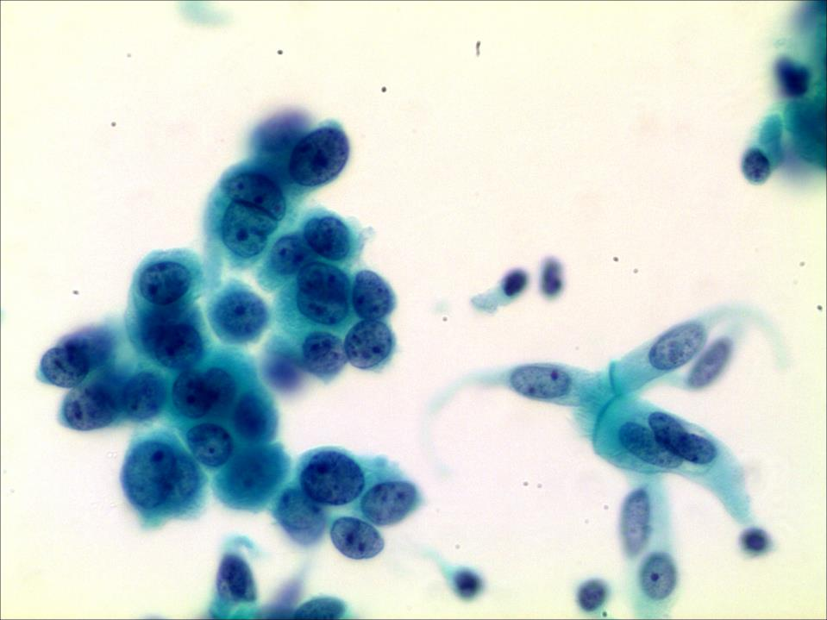
Adenocarcinoma
The nucleus are very clear: the nuclear chromatin is fine granular, slightly or moderately stained, and often has obvious single large nucleoli

Slide 27
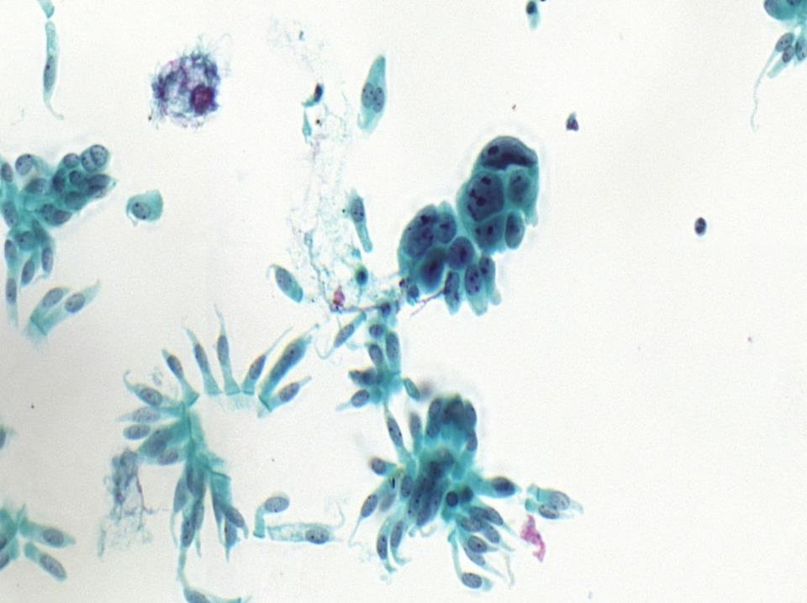
Squamous cell carcinoma
The nuclei are pleomorphic (heterogeneous shape), having irregular chromatin and prominent (multiple) nucleoli with inconsistent size and shape.

Slide 28
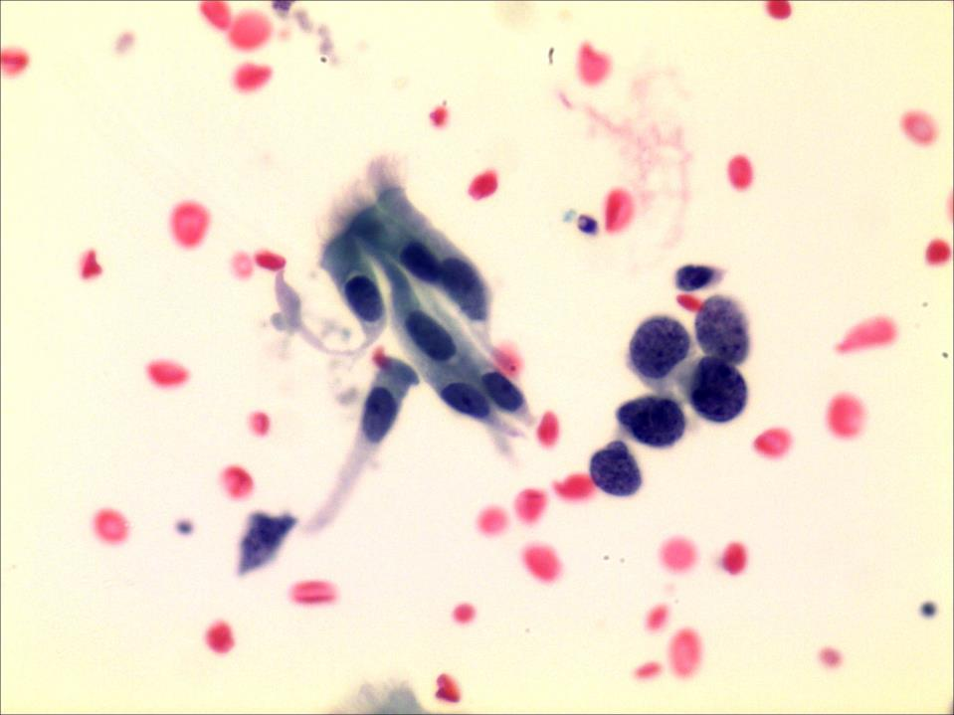

Small cell lung cancer
Round and spindle-shaped cells are deeply stained, having irregular nuclear membrane and small nucleoli.
Salt and Pepper Nuclear Chromatin

Slide 29
Need for AI
There is a serious shortage of cytopathologists in China and lack of systematic training
The emergence of whole-slide digital scanners and the advent of deep learning algorithms make the realization of cytology AI possible.
Many AI products for cervical cytology have been launched in the market but non-cervical cytology AI is emerging.

Slide 30
Two main AI application scenarios
Screen negatives: spare the pathologists from heavy workload
Assist in judging positives: present the cancer cells, sort them with the risk index, and then AI gives interpretation opinions.
Pathologists conduct a comprehensive analysis based on the AI ​​suggestions and write a report.

Slide 31
Thank you

